Slide 1


Slide 2

Online Booking Of Medical Appointments and Services

Slide 3
Group Member Introduction:
Name : Muhammad Asif & Faizan Ali
Group ID : F2202C0612
VU ID : BC190402820 & BC190406344

Slide 4

INTRODUCTION OF PROJECT:
Describes the requirements to build an application. It provides the surety that software development process is according to the expectation and needs for which it is built. Online booking of Medical Appointments and Services will be built for the same purpose. This application will meet the needs of post-COVID world. This application has extensive scope. This application will facilitate its users to get their medical checkups online. This will be an effective way to get an appointment without going out. This application will be effective in cost and time. This application will be useful for patients. This application will help users to arrange their appointments according to their availability. This application has Admin and user account. Admin is an authorized person. He will be able to manage and delete data of available hospitals respective to cities. He will also manage information on labs, medical specialists, users, city, clinic, and of doctors. He will be able to manage and update the doctor’s availability timing and his/her fee. Similarly, a patient is a registered user. This application will allow its user to find a doctor by using different filters such as the name of the hospital, clinic, lab, or doctor. This application will also provide the facility to its user to find a nearby doctor based on his/her current location or to find a doctor based in his city. This application is user-friendly this application will also give information about the availability of slots of a specific doctor to get an appointment. This application will also allow its user to check different information such as the date and timing of his appointment. This application will provide a facility for its user to get an appointment for a test and check reports from the test such as test radiology department scanning X-rays. These features collectively make our application user-friendly, less time-consuming, cost-efficient, efficient, reliable, speedy, and secure. Now if I talk about its availability and compatibility, it is easily accessible from anywhere around the world at any time on any kind of device which has browser support.

Slide 5
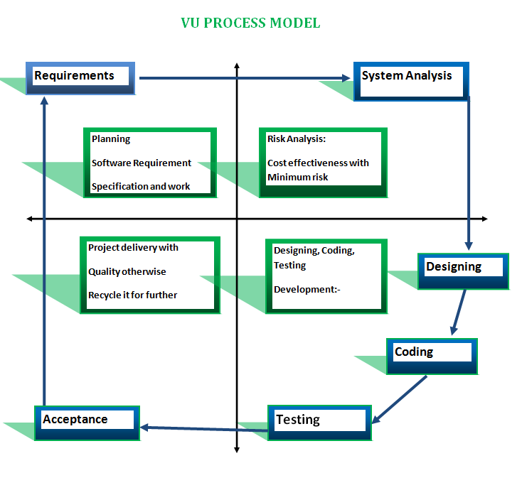
PROCESS MODEL:

Slide 6
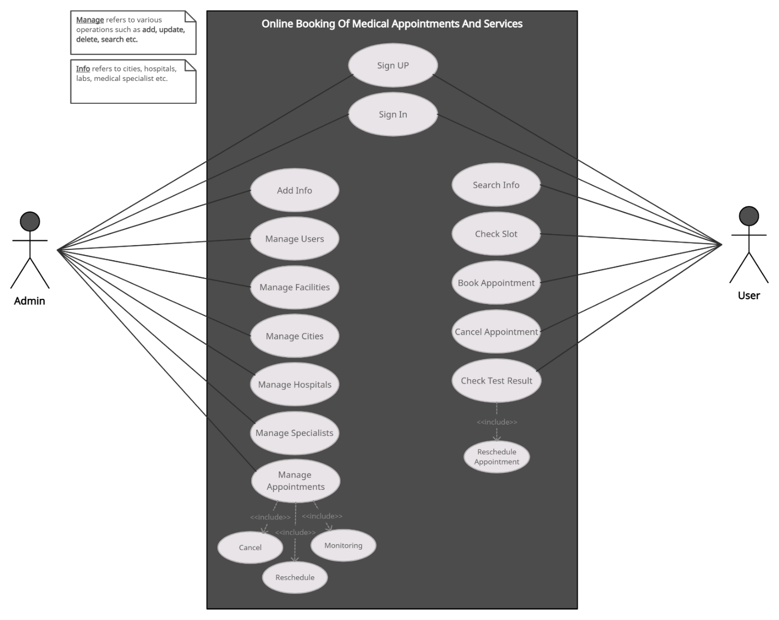
Use Case Diagram:

Slide 7
Business Rules Catalog (Functional Req.)
Note: The system has two Actors:
  Administration
  User
Admin Requirements:
Admin shall be able to maintain data of cities, hospitals, labs, medical specialist in the system after logged in.
Admin shall maintain information of users.
Admin shall add new facility offering by hospital
Admin shall add new city, clinic, hospital, lab and doctor information.
Admin shall add all information of a doctor/medical specialist, timings, fee and all other necessary information
Admin shall be able to add complete information of a hospital, clinic or lab like timings, location and other facilities.
Admin shall change the information of hospital, clinic, doctors and other information.
User Requirements:
User shall be able to register themselves.
User shall be able to login their account.
User shall be able to select city.
After selecting city, User shall be able to select nearby or preferred hospital/Clinic/Lab.
After selecting hospital, he or she has to select required facility.
User able to book online appointment from available doctor/medical specialist on respective date and time.
User shall be able to check free slot before booking appointment of doctor or test.
User able to book online appointment of paramedical service, test etc.
User able to book online appointment in radiology department for any type of scan or x-ray etc.
User able to see all information about doctor, timings, fees, and other required information.
User shall be able to check results of their test results in their respective account.
User shall be able to recheck date and time of their appointments.
User shall be able to cancel appointment to free slot.

Slide 8
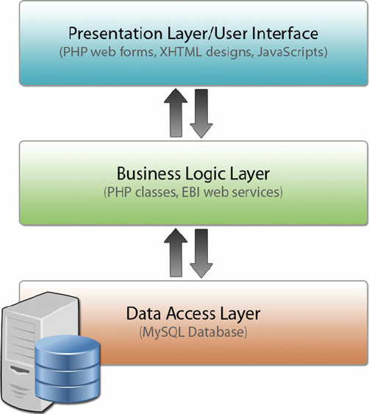
Architectural Design:

Slide 9
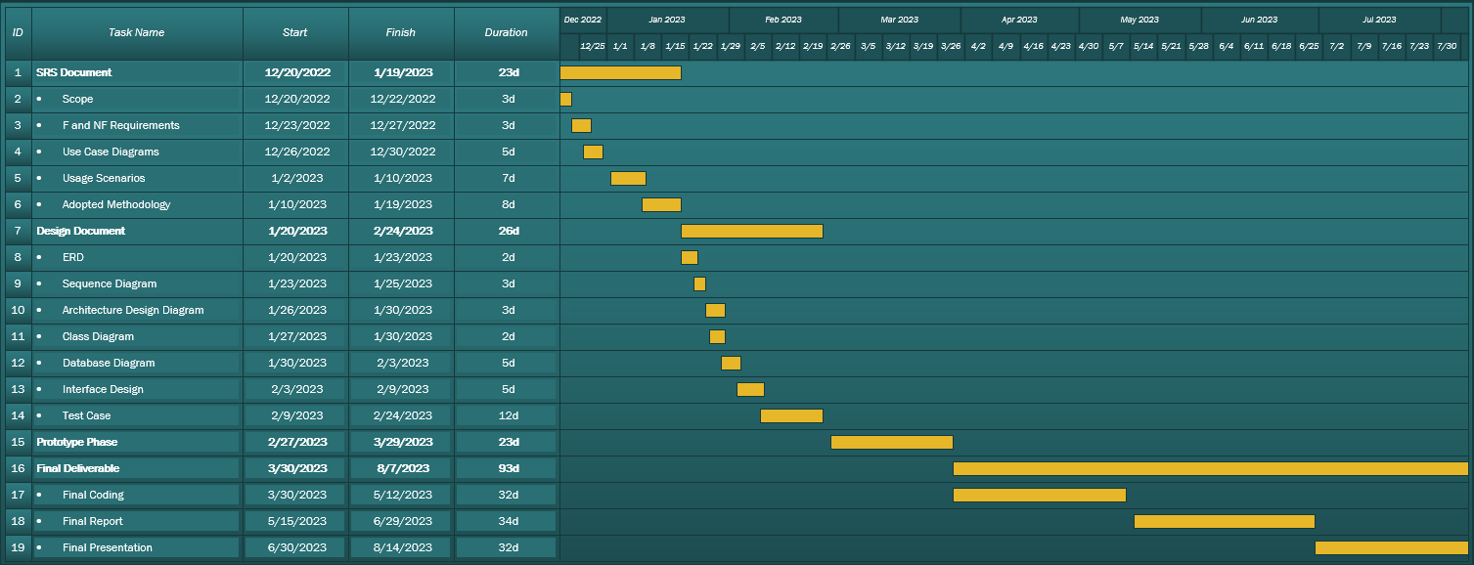
Project Schedule:

Slide 10
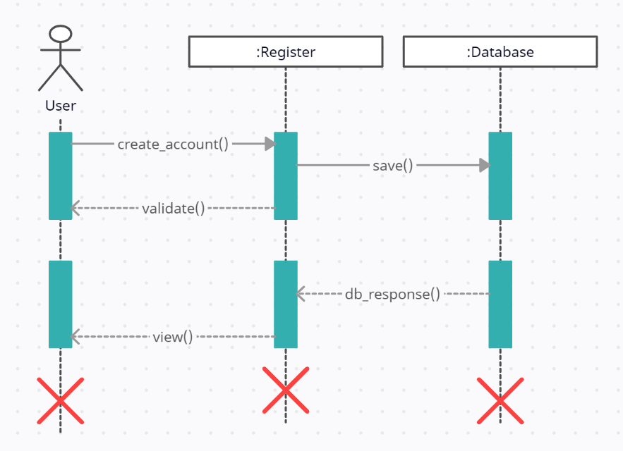
Sequence Diagrams:
CREATE ACCOUNT

Slide 11
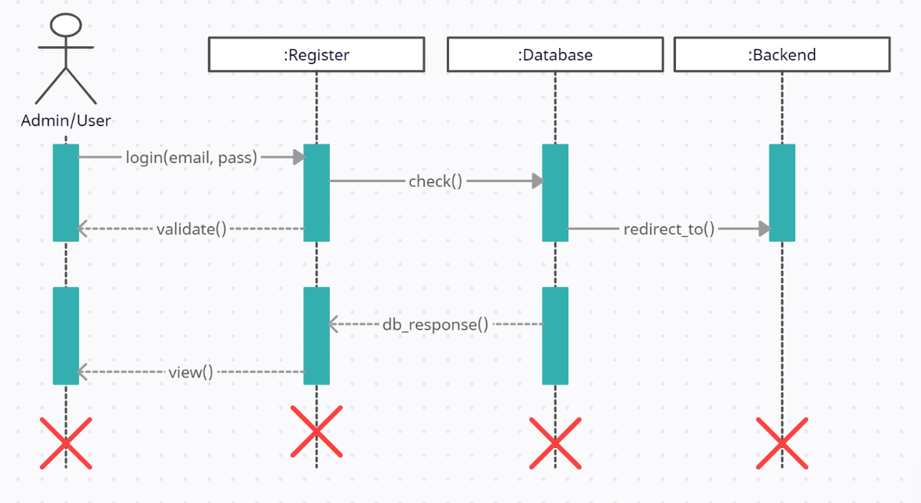
LOGIN

Slide 12
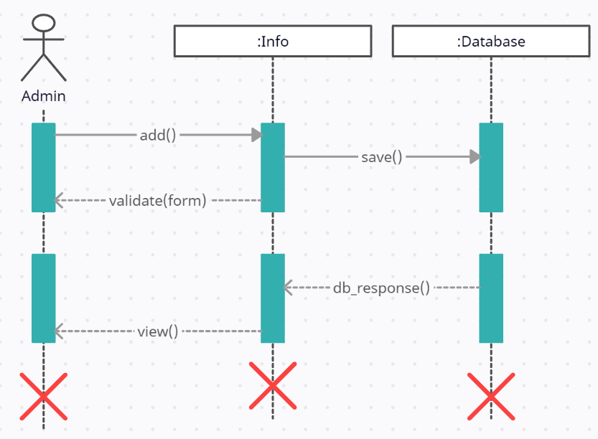
ADD INFO

Slide 13
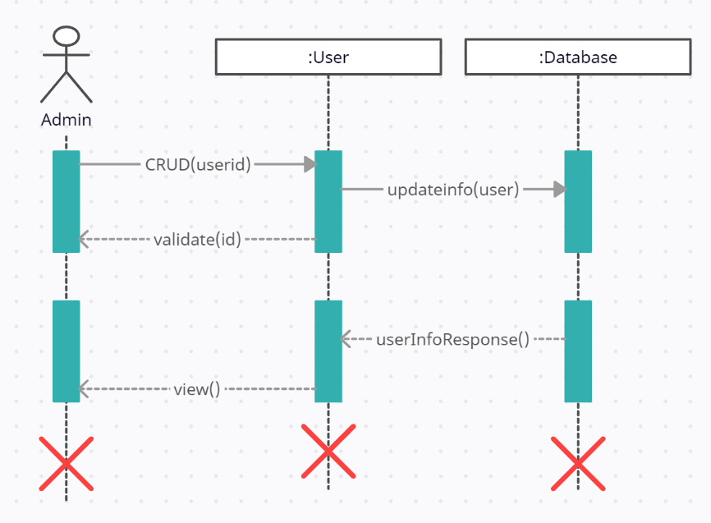
MANAGE USERS

Slide 14
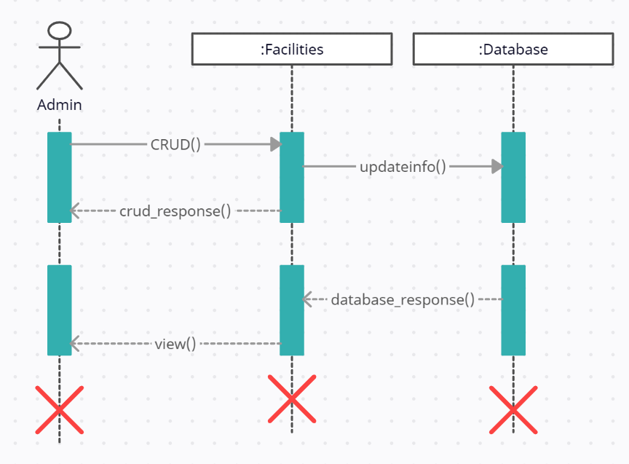
MANAGE FACILITIES

Slide 15
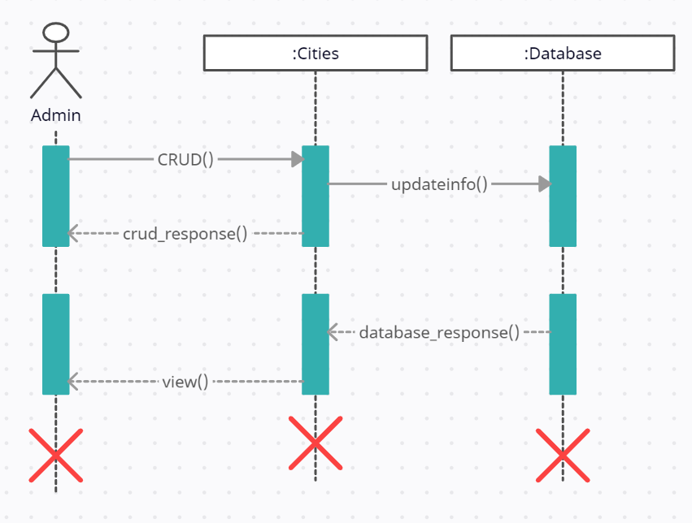
ADD CITIES

Slide 16
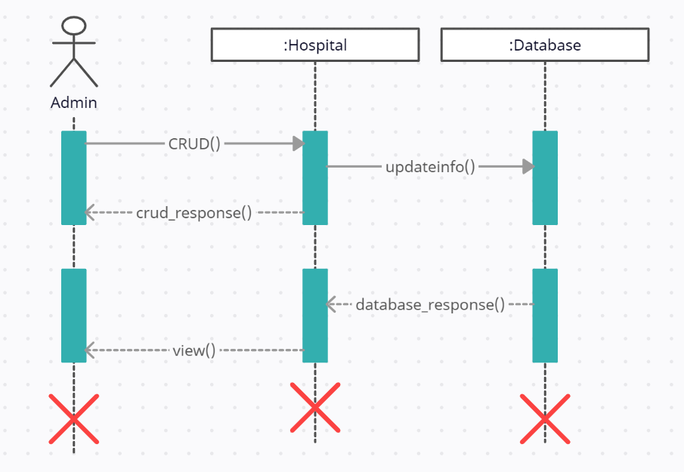
MANAGE HOSPITALS

Slide 17
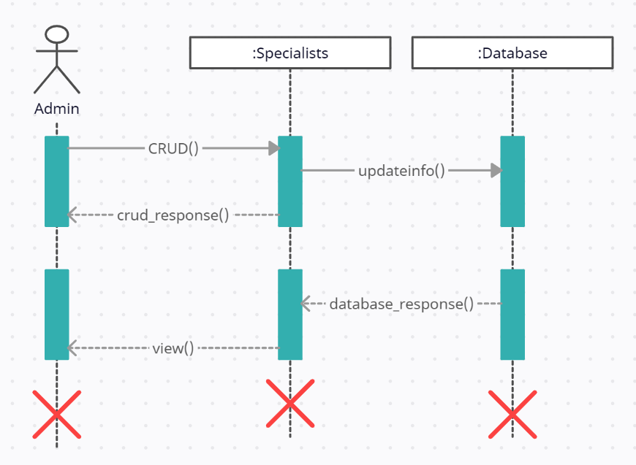
MANAGE SPECIALISTS

Slide 18
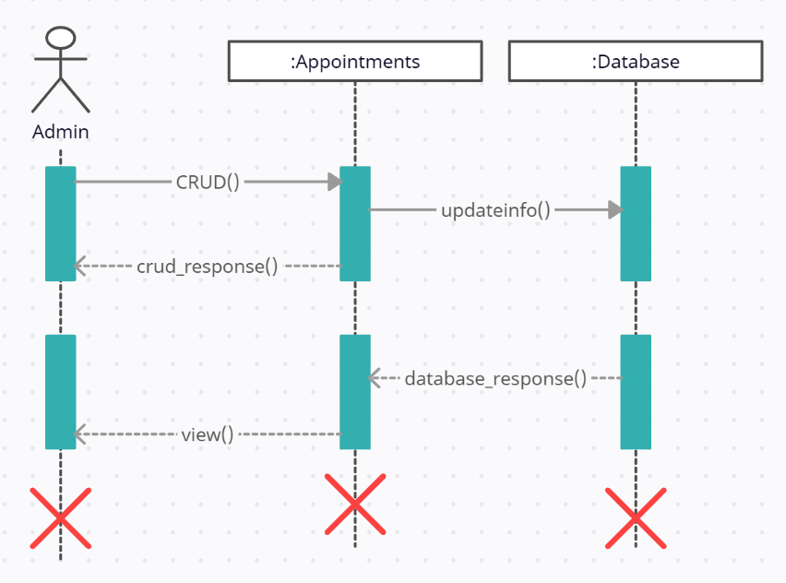
MANAGE APPOINTMENTS

Slide 19
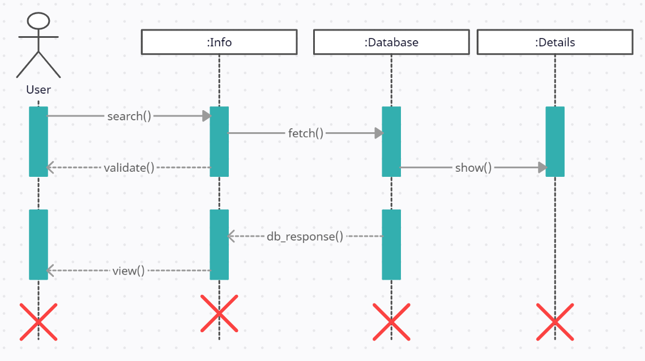
SEARCH INFO

Slide 20
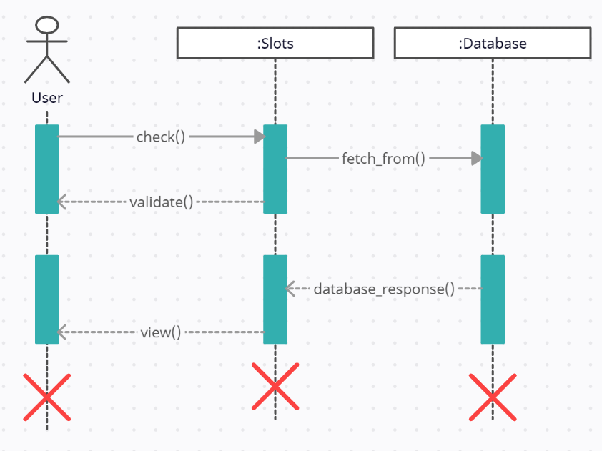
CHECK SLOTS

Slide 21
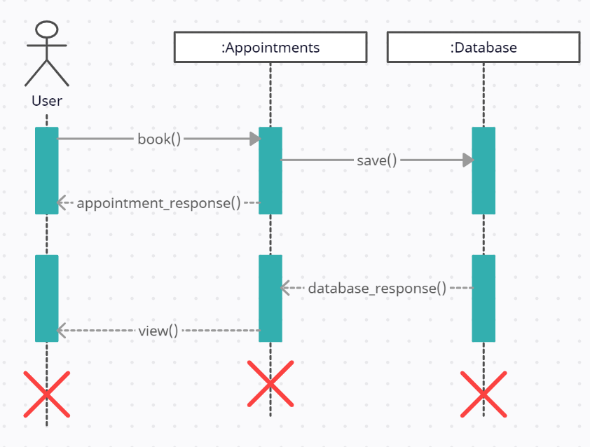
BOOK APPOINTMENTS

Slide 22
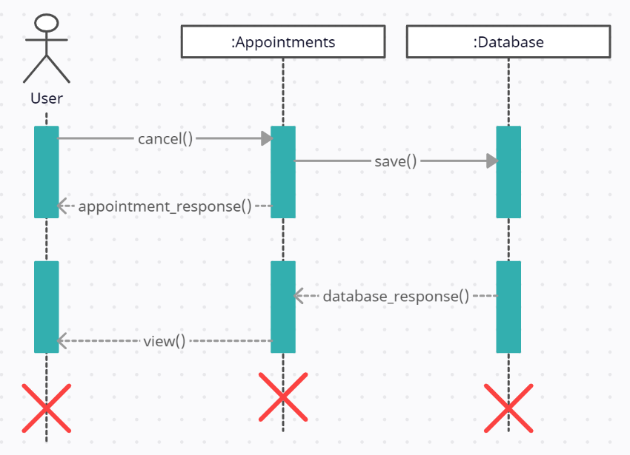
CANCEL APPOINTMENTS

Slide 23
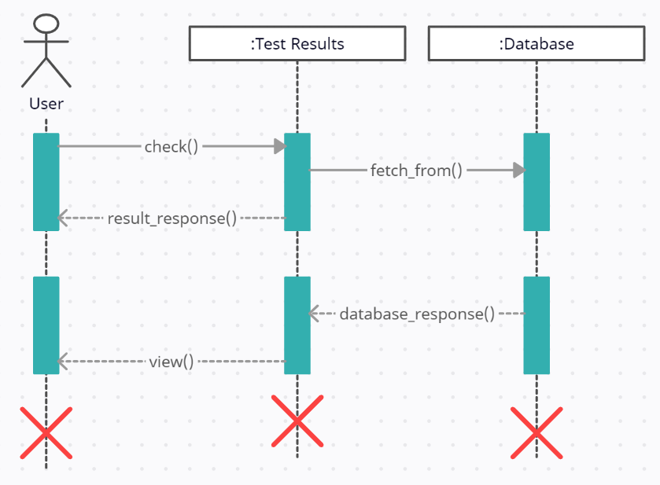
CHECK TEST RESULTS

Slide 24
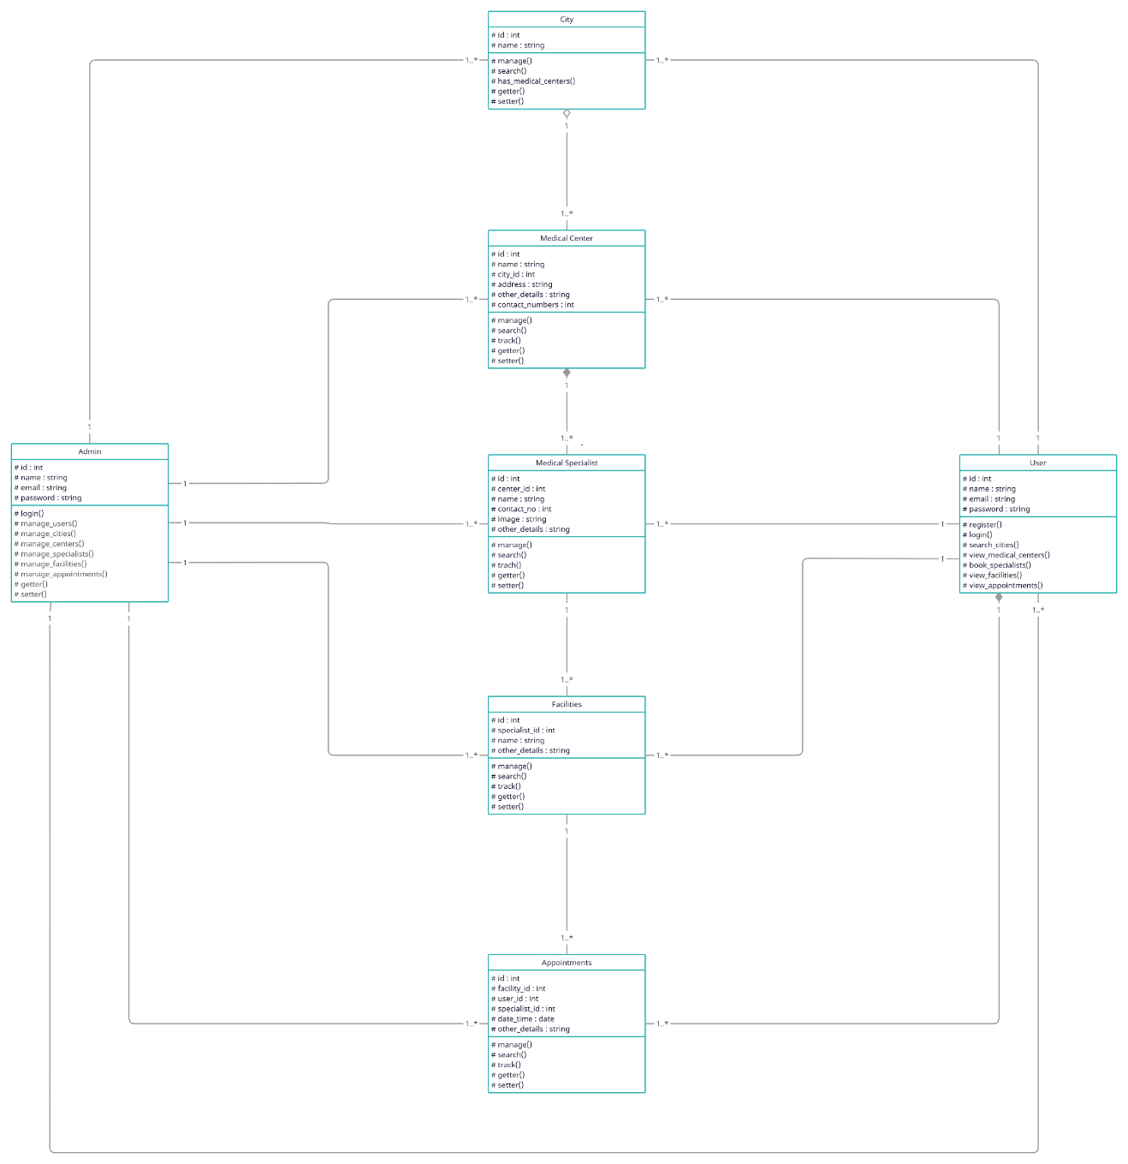
Logical Model/Class Diagram

Slide 25
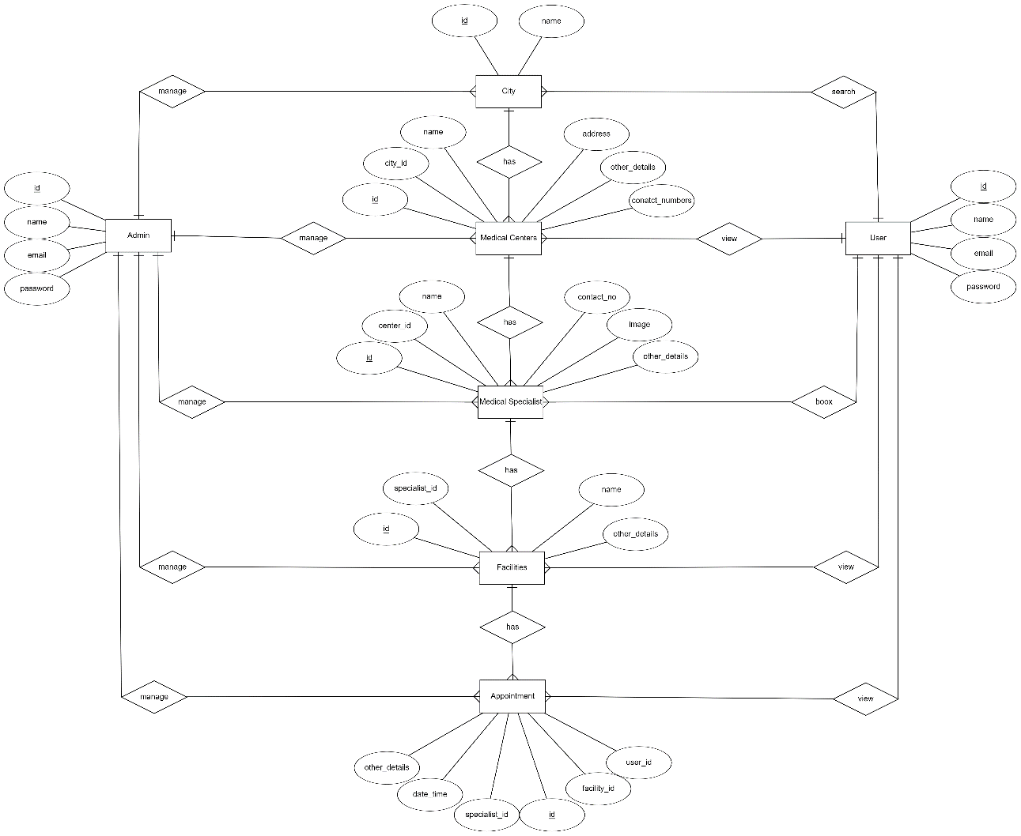
Entity-Relationship Diagram

Slide 26
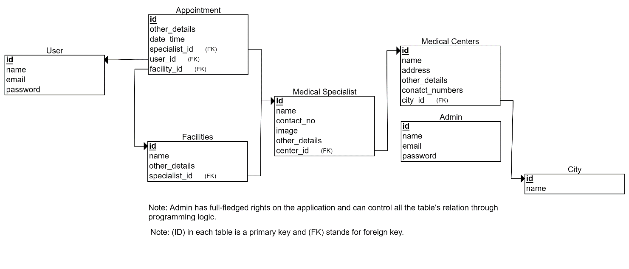
Database Diagram:

